Slide 1


Noida Institute of Engineering and Technology, Greater Noida
Text Summarization
Unit: 4
Social Media Analytics(ACSAI0622)
Areeba Atiq
Assistant Professor
AIML
B Tech 6th Sem

Slide 2


Faculty Introduction
Name | Areeba Atiq
Qualification | M. Tech. (Software Engineering)
Designation | Assistant Professor
Department | AIML
NIET Experience | 8 months
Subject Taught | Python, Advance Python,C Programming

Slide 3

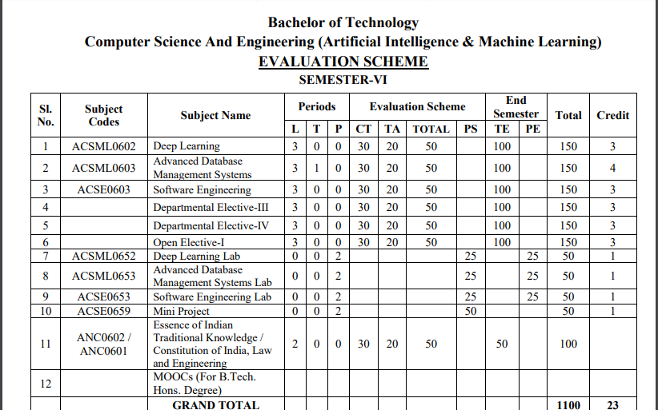
EVALUATION SCHEME

Slide 4

Syllabus
UNIT-I:SENTIMENT MINING
Overview: Text and Sentiment Mining, Semantic Analysis Applications, Sentiment Analysis Process, Speech Analytics, Text Representation- tokenization, stemming, stop words, TF-IDF, Feature Vector Representation, NER, N-gram modelling, Text Clustering, Text Classification, Topic Modelling-LDA, HDP. Sentiment Classification, feature based opinion mining, comparative sentence, and relational mining, Opinion summarization, Opinion spam detection.

Slide 5

Syllabus
UNIT-II:WEB MINING
Web Mining Overview, Web Structure Mining, Search Engine, Web Analytics, Machine Learning for extracting knowledge from the web, Inverted indices and Boolean queries. PLSI, Query optimization, SEO, page ranking, Social Graphs (Interaction, Latent and Following Graphs), Ethics of Scraping, Static data extraction and Web Scraping using Python

Slide 6
Syllabus
UNIT-III: MINING SOCIAL MEDIA
Introduction to Social Media Mining, Challenges in Social Media Mining, Process of Social media Mining, Essentials of Social graphs and its types, Social Networks Measures, Network Models, Information Diffusion in social media, Behavioural Analytics, Influence and Homophily, Recommendation in social media.

Slide 7
Syllabus
UNIT-IV: TEXT SUMMARIZATION
Introduction to Text Summarization, Text extraction, classification and clustering, Anomaly and Trend Detection, Text Processing, N-gram Frequency Count and Phrase Mining, Page Rank and Text Rank Algorithm, LDA Topic Modelling, Machine-Learned Classification and Semantic Topic Tagging, Python libraries for Text Summarization(NumPy, Pandas, NLTK, Matplotlib)

Slide 8
Syllabus
UNIT-V: RECENT TRENDS
Trend Analysis, Types of trend analysis, Recent Trends in Text, Data Localization, Role of Web Mining in E-Commerce, Social Media Analytics, Social Media Analytics tools.
Case Studies: Facebook Insights Using Python, Sentiment and Text Mining of Twitter data and Google analytics.

Slide 9
Branch Wise Application
1.Security
2. Digital Advertising
3. E-Commerce
4. Publishing
5. Massively Multiplayer Online Games
6. Backend Services and Messaging
7. Project Management & Collaboration
8. Real time Monitoring Services
9.Live Charting and Graphing
10. Group and Private Chat

Slide 10
Course Objective
To understand text mining and social media data analytic activities and apply the complexities of processing text and network data from different data sources.

Slide 11
Course Outcomes (COs)
At the end of course, the student will be able to:
Design new solutions to opinion extraction, sentiment classification and data summarization problems.
Apply a wide range of classification ,clustering ,estimation and prediction algorithms on web data.
Perform social network analysis to identify important social actors, subgroups and network properties in social media sites.
Interpret the terminologies ,metaphors of text summarization.
Apply state of the art mining tools and libraries on realistic data sets as a basic for business decisions and applications.

Slide 12
Program Outcomes (POs)
Engineering Graduates will be able to:
PO1 : Engineering Knowledge
PO2 : Problem Analysis
PO3 : Design/Development of solutions
PO4 : Conduct Investigations of complex problems
PO5 : Modern tool usage
PO6 : The engineer and society

Slide 13
Program Outcomes (POs)
Engineering Graduates will be able to:
PO7 : Environment and sustainability
PO8 : Ethics
PO9 : Individual and teamwork
PO10 : Communication
PO11 : Project management and finance
PO12 : Life-long learning

Slide 14

COs - POs Mapping
CO.K | PO1 | PO2 | PO3 | PO4 | PO5 | PO6 | PO7 | PO8 | PO9 | PO10 | PO11 | PO12
CO1 | 2 | 2 | 2 | 3 | 3 | - | - | - | - | - | - | -
CO2 | 3 | 2 | 3 | 2 | 3 | - | - | - | - | - | - | -
CO3 | 3 | 2 | 3 | 2 | 3 | - | - | - | - | - | - | -
CO4 | 3 | 2 | 3 | 2 | 3 | - | - | - | - | - | - | -
CO5 | 3 | 2 | 3 | 3 | 3 | - | - | - | - | - | - | -
AVG | 2.8 | 2.0 | 2.8 | 2.4 | 3.0 | - | - | - | - | - | - | -

Slide 15
Program Specific Outcomes(PSOs)
S. No. | Program Specific Outcomes (PSO) | PSO Description
1 | PSO1 | Should be able to understand the concepts of Data Science and their applications in the field of Agriculture, Healthcare, Education, Environment and other relevant areas.
2 | PSO2 | Should have an ability to apply technical knowledge and usage of modern tools and technologies related to Data Science for solving real world problems.
3 | PSO3 | Should have the capability to analyze, comprehend, design & develop Data based applications by working individually or and a team and thus demonstrating professional ethics & concern for societal well being

Slide 16
COs - PSOs Mapping
CO.K | PSO1 | PSO2 | PSO3 | PSO4
CO1 | 3 | - | - | -
CO2 | 3 | 2 | - | -
CO3 | 3 | 3 | - | -
CO4 | 3 | 3 | - | -
CO5 | 3 | 3 | - | -

Slide 17
Program Educational Objectives (PEOs)
Program Educational Objectives (PEOs) | PEOs Description
PEOs | To produce graduates with a strong foundation of basic science, Statistics & Engineering and ability to use modern tools and technologies to solve real-world complex problems/to address ever changing industrial requirements globally.
PEOs | To produce graduates who can inculcate life-long learning for up-skilling and re-skilling and get a successful career as data scientist, entrepreneur and bureaucrat for goodwill of the society.
PEOs | To produce graduates who can exhibit professional ethics and moral values with capability of working as an individual and as a team to contribute towards the need of industry and society.
Aarushi Thusu ACSAI0622 Social Media Analytics Unit 5

Slide 18

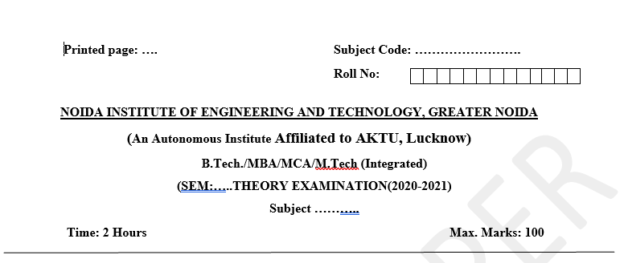
Pattern of External Exam Question Paper (100 marks)

Slide 19
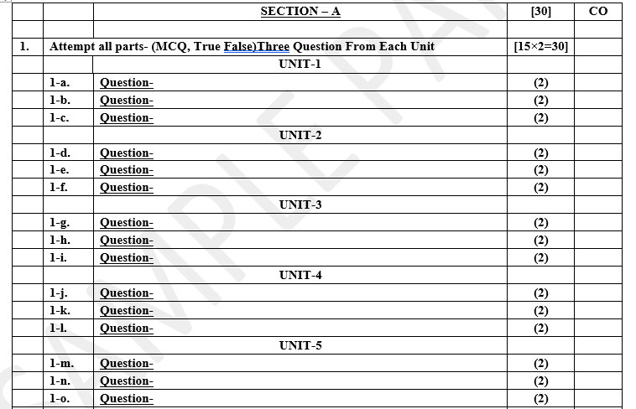
Pattern of External Exam Question Paper (100 marks)

Slide 20
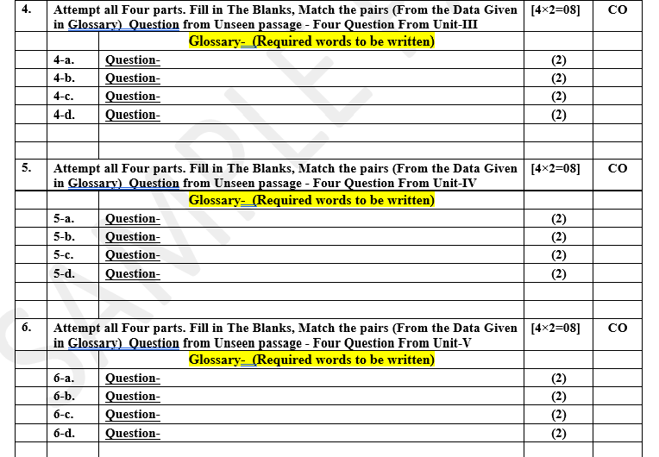
Pattern of External Exam Question Paper (100 marks)

Slide 21
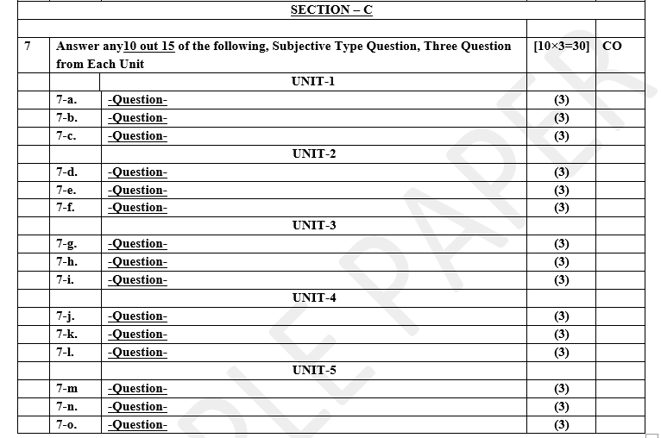
Pattern of Online External Exam Question Paper (100 marks)

Slide 22
Prerequisite / Recap
Student should have knowledge of Knowledge of Data Analysis Tools and Web Technology.
Students should have good knowledge of Python Programming and Python coding experience.
knowledge of Computer and basic skill.
Good problem solving Skill .

Slide 23
Brief Introduction about the Subject with videos
YouTube /other Video Links
https://www.youtube.com/watch?v=Uqs0GewlMkQ
https://www.youtube.com/watch?v=tUNwSH7671Y&t=2s
https://slideplayer.com/slide/14222744/
https://www.youtube.com/watch?v=KjWu1
dZn00https://www.youtube.com/watch?v=ntOaoW0T604

Slide 24

Unit 4 Content
Introduction to Text Summarization
Text Extraction
Classification and Clustering
Anomaly and Trend Detection
Text Processing
N-gram Frequency Count and Phrase Mining
Page Rank Algorithm
Text Rank Alogrithm
LDA Topic Modelling
Machine-Learned Classification and Semantic Topic Tagging
Python Libraries for Text Summarization(Numpy, Pandas, Nltk, Matplotlib)

Slide 25
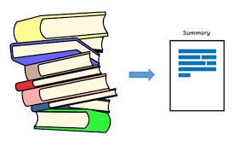
Introduction to Text Summarization
Text summarization refers to the technique of shortening long pieces of text. The intention is to create a coherent and fluent summary having only the main points outlined in the document.

Slide 26
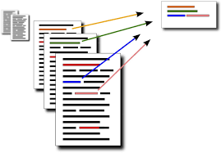
Introduction to Text Summarization
Automatic text summarization aims to transform lengthy documents into shortened versions, something which could be difficult and costly to undertake if done manually.

Slide 27
Introduction to Text Summarization
The need for text summarization:
With the present explosion of data circulating the digital space, which is mostly non-structured textual data, there is a need to develop automatic text summarization tools that allow people to get insights from them easily. For example, if you are looking for specific information from an online news article, you may have to dig through its content and spend a lot of time removing out the unnecessary stuff before getting the information you want. Implementing summarization can enhance the readability of documents, reduce the time spent in researching for information, and allow for more information to be fitted in a particular area.

Slide 28
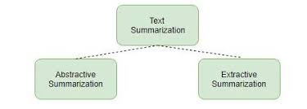
Introduction to Text Summarization
The main types of text summarization:
Broadly, there are two approaches to summarizing texts :
Abstraction-based summarization
Extraction-based summarization
Notes:
Extraction-based summarization

Slide 29
Introduction to Text Summarization
Extraction-based summarization:
In extraction-based summarization, a subset of words that represent the most important points is pulled from a piece of text and combined to make a summary. In machine learning, extractive summarization usually involves weighing the essential sections of sentences and using the results to generate summaries. In machine learning, extractive summarization usually involves weighing the essential sections of sentences and using the results to generate summaries. Different types of algorithms and methods can be used to gauge the weights of the sentences and then rank them according to their relevance and similarity with one another—and further joining them to generate a summary.

Slide 30
Introduction To Text Summarization
Abstraction-based summarization:
In abstraction-based summarization, advanced deep learning techniques are applied to paraphrase and shorten the original document, just like humans do. Since abstractive machine learning algorithms can generate new phrases and sentences that represent the most important information from the source text, they can assist in overcoming the grammatical inaccuracies of the extraction techniques.

Slide 31
Questions
Which of the below are NLP use cases?
a) Detecting objects from an image b) Facial Recognition
c) Text Summarization d) Speech Biometric
2) Deciding Insurance premium of a car based on online customers reviews is an application of:
a) Information Retrival b) Information Extraction
c) Sentiment Analysis d) Text Summarization

Slide 32
Text Extraction
Text extraction is the process of systematically retrieving relevant information from unstructured textual data, transforming it into a structured and analyzable format.
This extraction can involve identifying and isolating specific pieces of information, such as entities, keywords, or sentiments, from a body of text.
Text extraction is performed to distill meaningful insights, facts, or patterns from large volumes of unstructured text.
Text extraction refers to the process of extracting relevant information or features from unstructured textual data. Unstructured data includes free-form text found in documents, articles, social media posts, websites, and more. Text extraction is a fundamental step in natural language processing (NLP) and data analysis, aiming to convert raw text into a structured and analyzable format.

Slide 33
Type of Data Extraction
Text extraction encompasses various techniques to extract specific types of information from unstructured text. Here are some common types of text extraction:
Named Entity Recognition (NER):
Identifying and classifying entities such as names of people, organizations, locations, dates, percentages, and other specific terms within a text.
Keyword Extraction:
Identifying and extracting important words or phrases that represent the main topics or themes in a document. This helps in understanding the key concepts discussed in the text.

Slide 34
Sentiment Analysis: Determining the sentiment expressed in a piece of text, whether it is positive, negative, or neutral. This is valuable for understanding opinions and attitudes in reviews, social media posts, and other textual content.
Text Summarization: Creating concise and coherent summaries of longer texts while retaining the essential information. This is useful for quickly understanding the main points of a document.
Text Classification:Categorizing texts into predefined classes or categories based on their content. This is often used in applications such as spam detection, topic categorization, and sentiment categorization.
Entity Relation Extraction:Identifying and extracting relationships between different entities mentioned in the text. For example, determining the relationships between people, organizations, and locations mentioned in news articles.

Slide 35
Challenges of manual text extraction
Manual text extraction works well if you have a single document to extract from with the same format. But, if you have to extract data from hundreds of PDFs with different layouts, then manual extraction can become challenging.
Time-consuming
It takes time to go through different documents and extract the text correctly. For example, if you are a food delivery company, time is of the essence. The moment you receive an order confirmation, the customer’s details have to be retrieved quickly and shared with your team.
Prone to errors
Undoubtedly, manual text extraction results in many human errors which go unnoticed. Imagine the wrong food orders being delivered to one of your customers.

Slide 36
Classification
Classification is a supervised machine learning task where the goal is to categorize or label items into predefined classes or categories based on their features.
It falls under the category of supervised learning, meaning the algorithm is trained on a labeled dataset where the correct class labels are known.
The model is trained using a dataset that includes both the features of the data points and their corresponding class labels.
Features are the characteristics or attributes of the data points that influence the classification outcome.

Slide 37
Classification
During model training, the algorithm learns patterns and relationships between features and class labels in the training data.
The trained model is then used to predict the class labels of new, unseen data based on their features.
Classes represent the predefined categories or groups that the model aims to assign to the data points.
The accuracy of the model is often measured by comparing its predictions to the actual class labels in a test dataset.
Logistic Regression, Decision Trees, Support Vector Machines, and Neural Networks are common algorithms used for classification tasks.

Slide 38
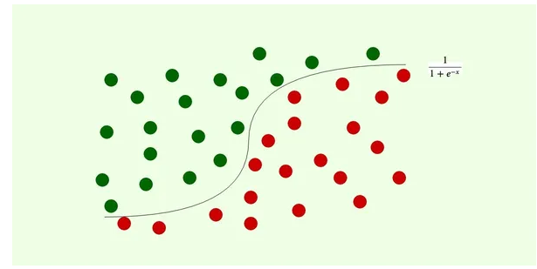
Type of Classification
Binary Classification
This is the simplest type of classification. Here data is bifurcated into precisely two categories/classes. The most standard example would be email classification— classifying emails as spam or not spam.

Slide 39
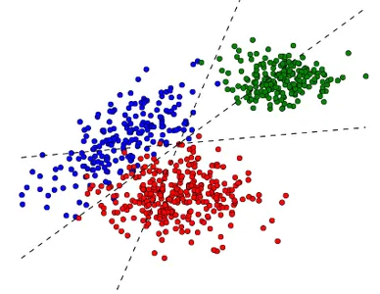
Type of Classification
Multi-class Classification
It is called multi-class classification when there are more than two classes/categories. For example, classifying an image of a fruit into different fruit types such as apple, banana, and orange.

Slide 40
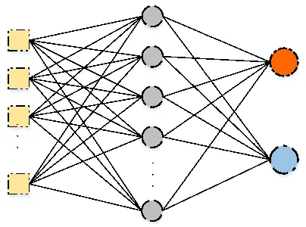
Classification Alogrithms
Neural Network Classification
Neural networks are complex mathematical models trained on large amounts of data to learn complex patterns and relationships. The most widely used neural networks are convolutional neural networks (CNNs), mainly used for image-based classification problems.

Slide 41
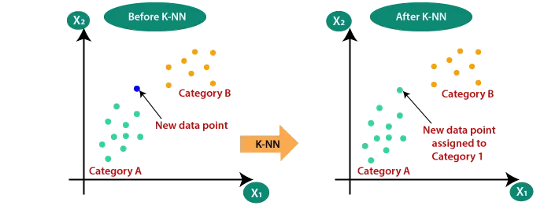
Classification Alogrithms
K-Nearest Neighbor Classification
This algorithm classifies data points based on their proximity to other data points. The class of a data point is assigned based on the class of its k-nearest neighbors.

Slide 42
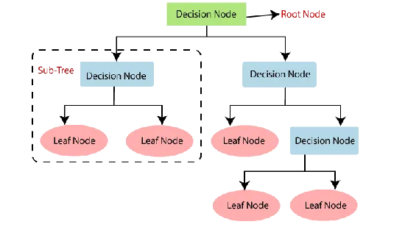
Classification Alogrithms
Decision Tree Classification
This popular classification algorithm uses tree-like structures, called decision trees, where each node in the tree showcases a predetermined feature or attribute of the data. Secondly, each leaf node represents a class. The tree is constructed by recursively splitting the data based on the values of the features until a leaf node is reached.

Slide 43
Clustring
Clustering is an unsupervised machine learning task where the goal is to group similar data points together based on their intrinsic characteristics or similarities.
Clustering is categorized as unsupervised learning because it doesn't rely on labeled data; it identifies patterns based on the inherent structure of the data.
Clustering involves grouping individual data points into clusters based on their similarities, without prior knowledge of class labels.
A similarity measure, such as Euclidean distance or cosine similarity, quantifies how similar or dissimilar two data points are to each other.

Slide 44
Clustring
Clusters are formed by grouping data points that are more similar to each other than to those in other clusters.
Centroids are representative points within each cluster that summarize the characteristics of the data points in that cluster.
The number of clusters can be determined by the algorithm or specified by the user based on the desired granularity of grouping.
Clustering is particularly useful when dealing with large datasets or when the data lacks predefined class labels.

Slide 45
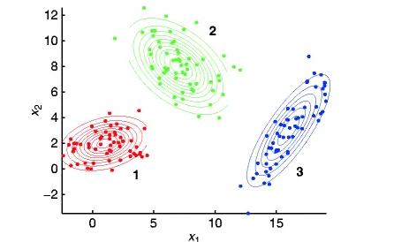
Types of Clustering
Model-based Clustering
This clustering approach uses statistical models to group similar data points into clusters. The goal is to find a model to explain the observed data as a mixture of different probability distributions. The number of distributions and their parameters are estimated using a maximum likelihood or Bayesian approach.
Poisson distributions, a mixture of exponential distributions, t-distributions, and a few others can also be used to form clusters in a model-based setting. Though, it depends on the type of data in the picture. Some of the most common applications of model-based clustering include image segmentation, gene expression analysis, and customer segmentation.

Slide 46
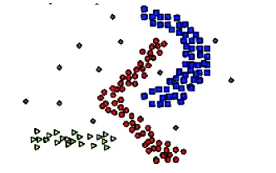
Text Extraction
Density-based Clustering
Imagine a crowded city with people gathering in specific areas (like parks, theatres, restaurants, etc.) based on their interests. For example, foodies might gather in a neighborhood known for its restaurants.
Density-based clustering is a method in data analysis that groups data points closely packed together in high-density regions. These data points belong to the same cluster, similar to people in the same area. Data points that are isolated in areas of low density are considered as noise and not assigned to any cluster, similar to how people who are not part of any particular group.

Slide 47
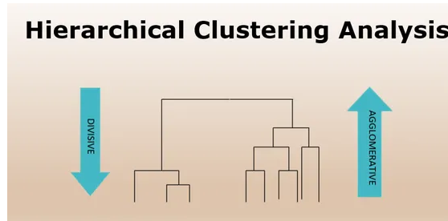
Clustring
Hierarchical Clustering
A clustering technique that results in tree-like structures of nested clusters having similar/merging data points based on their similarity. It can be either agglomerative (starting with individual data points and merging them into larger clusters) or divisive (starting with all data points as one large cluster and recursively splitting it into smaller clusters).
Examples of Hierarchical clustering include CURE (clustering using representative), BIRCH (balanced iterative reducing clustering and using hierarchies), etc.
Hierarchical clustering is widely used for biological classification, social network analysis, natural language processing, time series analysis, and many others.

Slide 48
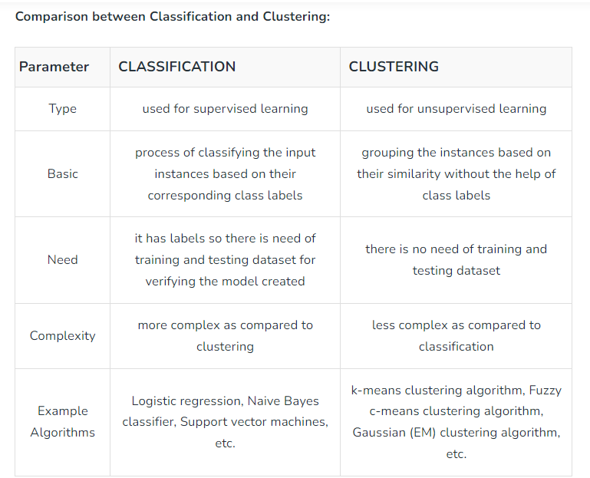
Classification Vs Clustering

Slide 49
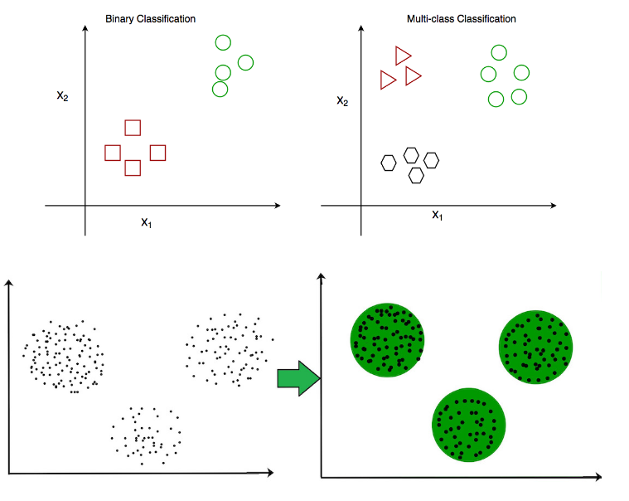
Classification Vs Clustering

Slide 50
Anomaly Detection
Anomaly detection is a data analysis technique aimed at identifying patterns or instances in data that deviate significantly from the norm or expected behavior.
Anomaly detection is often performed using unsupervised learning techniques since labeled anomaly data may be scarce.
Anomalies can manifest as spikes, dips, or unexpected patterns in time-series data or as outliers in multidimensional feature spaces.
Widely used in fraud detection, network security, quality control, and healthcare for identifying unusual patterns or behaviors.
Common techniques include statistical methods, machine learning algorithms (such as isolation forests or one-class SVM), and deep learning approaches.

Slide 51
v
Type of Anomaly Detection
Anomalies can be of various types, including
point anomalies (individual data points deviating),
contextual anomalies (anomalous in a specific context),
collective anomalies (anomalies detected only when considering a collection of data points).

Slide 52
Trends Detection
Trend detection involves identifying the underlying patterns or tendencies in data that indicate a general direction or tendency over time.
Commonly applied to time-series data to identify trends, cycles, or recurring patterns.
Trends can be upward (increasing), downward (decreasing), or cyclic (repeating patterns over specific intervals).
Used in finance to predict market trends, in environmental monitoring to track climate trends, and in business for sales forecasting.

Slide 53
Trends Detection
Anomaly detection and trend detection are both valuable techniques for gaining insights from data, each serving different purposes in identifying unusual occurrences and understanding the underlying patterns or directions in the data.

Slide 54
Text Processing
The term text processing refers to the automation of analyzing electronic text. This allows machine learning models to get structured information about the text to use for analysis, manipulation of the text, or to generate new text.
Text processing is one of the most common tasks used in machine learning applications such as language translation, sentiment analysis, spam filtering, and many others.

Slide 55
Text Processing
Why is text processing important?
Since text processing is one of the machine learning uses that average technology consumers don’t even realize they’re using, but most people use apps daily that are using text processing behind the scenes.
Since our interactions with brands have become increasingly online and text-based, text data is one of the most important ways for companies to derive business insights. Text data can show a business how their customers search, buy, and interact with their brand, products, and competitors online. Text processing with machine learning allows enterprises to handle these large amounts of text data.

Slide 56
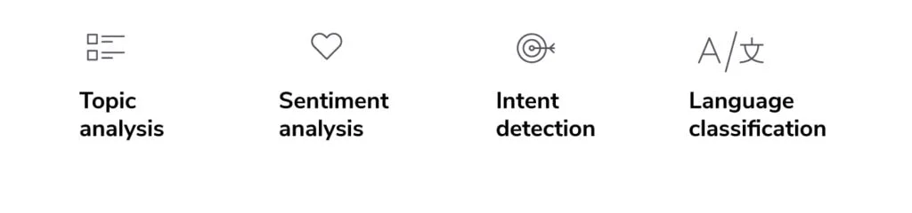
Text Processing
How is text processing used?

Slide 57
Text Processing
Topic analysis – This technique interprets and categorizes large collections of text into topics or themes.
Sentiment analysis – This function automatically detects the emotional undertones of text and classifies them as positive, negative, or neutral.
Intent detection – This classification model detects the intent, purpose, or goal of the text. For example, it may determine whether the intent is to gain information, make a purchase, or unsubscribe from the company.
Language classification – This classifies text based on which language it’s written in.

Slide 58
Questions
What is text Summarization?
What is information extraction?
What are the major challenges of text processing?
Why is text processing important?

Slide 59
Page Rank Algorithm
PageRank was and published by Sergey Brin and Larry Page at the Seventh World Wide Web Conference (WWW7) in April 1998
The aim of this is track some with the ranking algorithms of early search engines which used text for webpages to retrieve the information with no explicit of link between them.
PageRank (PR) is an algorithm used by Google Search to rank websites in their search engine results. PageRank was named after Larry Page, one of the founders of Google. PageRank is a way of measuring the importance of website pages. According to Google:
“PageRank works by counting the number and quality of links to a page to determine a rough estimate of how important the website is. The underlying assumption is that more important websites are likely to receive more links from other websites.”

Slide 60
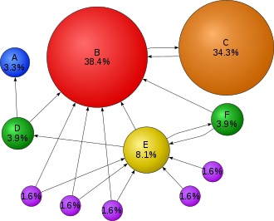
Page Rank Algorithm
A simple illustration of the Pagerank algorithm. The percentage shows the perceived importance, and the arrows represent hyperlinks.

Slide 61
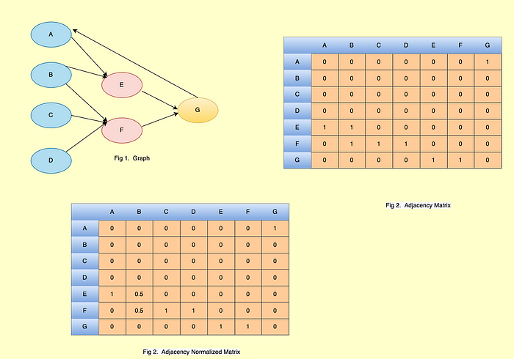
Page Rank Algorithm
PageRank is a very popular algorithm by google which used to calculate the weight of web pages, which in the under-hood a graph-based algorithm is used to rank the webpages.

Slide 62
Page Rank Algorithm
We have 7 web pages namely A, B, C, D, E, F, G, I, represented in the graph as shown in fig 1, each webpage is a node in graph and arrows signify direct relation, meaning in a chunk of the text of webpage E has links for web page G.
Fig2 represents the outgoing links between webpages, that is B has an outgoing link to E and F similarly, F has outgoing links to G. And each outgoing link is mapped to a value of 1 in matrix else 0.
Fig 3 is just a normalisation of outgoing links, as B has 2 outgoing links so, each outbound link will be averaged to 0.5.

Slide 63
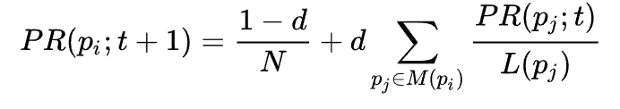
Page Rank Algorithm
Formula of PageRank
PR(p_i, t) → Page rank at t^th iterations for i^th webpage.
d → Damping Factor (Way to do teleportation)
L→ length of outgoing links
N→ length of webPages

Slide 64
Page Rank Algorithm
Algorithms:
Initialise a vector “V” where all element is equal to 1 and size is equal to the number of nodes. and also define no of iteration “Iter”.
Normalize Vector “V”.
Take the damping factor value like “0.85”.
Compute the PageRank of each node by the above formula.
repeat step 4 for a given number of iterations “Iter”..

Slide 65
Text Rank Algorithm
Similar to page Rank, text rank is also a graph-based ranking algorithm. Instead of webpage links, TextRank algorithms work on words and sentences(word embedding or sentence embedding). And Instead of counting incoming links here, the similarity between sentences is used.
“In Laymen terms what TextRank does is very simple it finds how similar each sentence is to all other sentences. and one which is most similar to other sentences are ranked higher.”

Slide 66
Text Rank Algorithm
Algorithms
Take a document with n sentence.
compute embedding of each sentence using Tf-IDF, Bert, etc.
calculate the similarity between each sentence, which will be nothing but a matrix M which you see above in implementation.
Normalise the cosine Matrix M, so that each row sum equals one.
Then use page rank algorithms to compute the rank of each sentence.

Slide 67
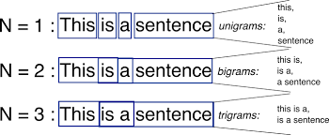
N-gram Frequency Count and Phrase Mining
N-gram:
N-gram can be defined as the contiguous sequence of n items from a given sample of text or speech. The items can be letters, words, or base pairs according to the application. The N-grams typically are collected from a text or speech corpus (A long text dataset).

Slide 68
N-gram Frequency Count and Phrase Mining
N-gram Language Model:
An N-gram language model predicts the probability of a given N-gram within any sequence of words in the language. A good N-gram model can predict the next word in the sentence.
Example of N-gram such as unigram (“This”, “article”, “is”, “on”, “NLP”) or bi-gram (‘This article’, ‘article is’, ‘is on’, ’on NLP’).

Slide 69
N-gram Frequency Count and Phrase Mining
N-gram frequency:
The mean, or summed, frequency of all fragments of a word of a given length. Most commonly used is bigram frequency, using fragments of length 2. The word 'dog' will contain 2 bigrams: 'do' and 'og'. Bigram frequency is considered to be a measure of orthographic regularity and normally has a negative correlation with response times in psycho-linguistic experiments.
It is not unusual to extend the word with a couple of 'space' characters, to give the first and last character in the word a special status. The word 'dog' will then become '_dog_' and now contains 4 bigrams: '_d', 'do', 'og' and 'g_'.
N-gram frequency of length 1 is equal to the character frequency, and using length 3 is commonly referred to as trigram frequency. Larger values for N are rare.

Slide 70
N-gram Frequency Count and Phrase Mining
What does mining mean in text?
Text mining, also known as text data mining, is the process of transforming unstructured text into a structured format to identify meaningful patterns and new insights. By applying advanced analytical techniques, such as Naïve Bayes, Support Vector Machines (SVM), and other deep learning algorithms, companies are able to explore and discover hidden relationships within their unstructured data.
Text is a one of the most common data types within databases. Depending on the database, this data can be organized as: structured data, unstructured data and semi structured data.

Slide 71
N-gram Frequency Count and Phrase Mining
Text mining techniques:
The process of text mining comprises several activities that enable you to deduce information from unstructured text data. Before you can apply different text mining techniques, you must start with text preprocessing, which is the practice of cleaning and transforming text data into a usable format. This practice is a core aspect of natural language processing (NLP) and it usually involves the use of techniques such as language identification, tokenization, part-of-speech tagging, chunking, and syntax parsing to format data appropriately for analysis. When text preprocessing is complete, you can apply text mining algorithms to derive insights from the data. Some of these common text mining techniques include: Information retrieval, Natural language processing (NLP), Information extraction, Data mining.

Slide 72
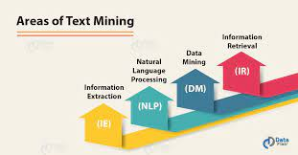
N-gram Frequency Count and Phrase Mining
Phrase Mining:
Phrase mining refers to the process of automatic extraction of high-quality phrases (e.g., scientific terms and general entity names) in a given corpus (e.g., research papers and news).

Slide 73
LDA Topic Modelling
Topic Modelling:
The purpose of this NLP step is to understand the topics in input data and those topics help to analyze the context of the articles or documents. This step will also further help in data labeling needs using the topics generated in this step across each set of similar documents.
The main purpose of this unsupervised statistical modeling algorithm is to understand the topics in the input data.
The algorithm used for generating topics: LDA

Slide 74
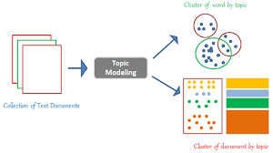
LDA Topic Modelling
The algorithm used for generating topics: LDA
LDA (Latent Dirichlet Allocation) is a generative statistical model that allows a set of observations to be explained by unobserved groups that explain why some parts of the data are similar.
It treats documents just as a collection of words or a bag of words.
LDA assumes that documents are composed of words that help determine the topics and then maps the similar documents to the list of topics by assigning each word in the document to different topics.

Slide 75
LDA Topic Modelling
Steps involved in order to feed the data to the LDA model:
Step-1: Read the pre-processed dataset.
Step-2: Read N-Grams
In this step, the function created will read the text files passed and return the list.
In the same step, the other function will read bigrams & trigrams and return the list of N_Grams.
Step-3: Generating combined N_Grams
This step will read the N_Grams obtained & will return the list of combined N_Grams using ‘_’.

Slide 76
LDA Topic Modelling
Step-4: Mapping of combined N_Grams to that of individual N_Grams
This step will do the mapping and will return the dictionary.
Step-5: Adding N_Grams back into the text of each article in the dataset.
This step will replace the original occurrence of N_Grams in the text with that of combined N_Grams.
Step-6: Removing the Stop Words from the input text.
This is the crucial step as such words don’t play any role in defining the topics.

Slide 77
LDA Topic Modelling
Step-7: Removing the punctuations.
We actually considered some special characters (.,?!) as valid for our future work, but the topic modeling step does not require the punctuations at all.
Remember! The idea behind topic modeling is that the documents are comprised of Topics and Topics are made of words. So, no need of keeping the punctuations here.
Step-8: Tokenization
Breakdown of text as a list of tokens to create dictionary and document term matrix for the topic model.
The result will be a list of list of input text.

Slide 78
LDA Topic Modelling
Step-9: Filtering of Tokens on the basis of POS_Tags.
This function will tag part of speeches corresponding to every token in the Corpus using NLTK.
Step-10: Create Dictionary and Document term matrix
Used the tokenized input of data and prepared the Dictionary and Document Term matrix.

Slide 79
LDA Topic Modelling
Step-11: Prepare the Topic models.
Train LDA model on different values of k.
The LDA model needs good memory and cores to train faster.
Therefore, selecting the Chunk size parameter wisely is really important.
I have run the model 10 times to get improved results.
Do not forget to keep all the results, as it may happen that the first result among all 10 would be the best of all.
Step-12: Generate Coherence scores.

Slide 80
Questions
Topic modeling is……………….
The process of obtaining the root word from a given word is known as:
While performing Topic modeling(LDA) which python package we use…………..
The basic assumption of topic modelling is ……..

Slide 81
Machine-Learned Classification and Semantic Topic Tagging
Text classification is a machine learning technique that assigns a set of predefined categories to open-ended text. Text classifiers can be used to organize, structure, and categorize pretty much any kind of text – from documents, medical studies and files, and all over the web.
For example, new articles can be organized by topics; support tickets can be organized by urgency; chat conversations can be organized by language; brand mentions can be organized by sentiment; and so on.
Text classification is one of the fundamental tasks in natural language processing with broad applications such as sentiment analysis, topic labeling, spam detection, and intent detection.

Slide 82
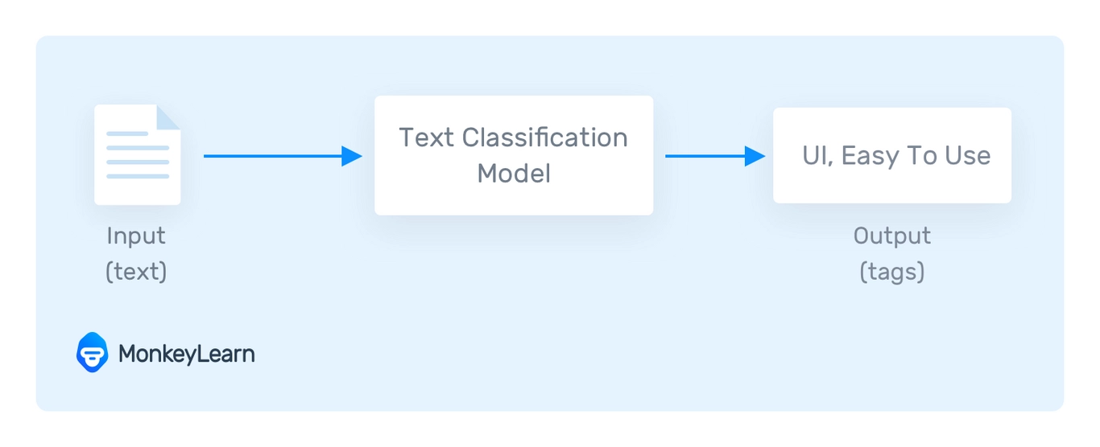
Machine-Learned Classification and Semantic Topic Tagging
A text classifier can take this phrase as an input, analyze its content, and then automatically assign relevant tags, such as UI and Easy To Use.

Slide 83
Machine-Learned Classification and Semantic Topic Tagging
Why is Text Classification Important?
It’s estimated that around 80% of all information is unstructured, with text being one of the most common types of unstructured data. Because of the messy nature of text, analyzing, understanding, organizing, and sorting through text data is hard and time-consuming, so most companies fail to use it to its full potential.
This is where text classification with machine learning comes in. Using text classifiers, companies can automatically structure all manner of relevant text, from emails, legal documents, social media, chatbots, surveys, and more in a fast and cost-effective way. This allows companies to save time analyzing text data, automate business processes, and make data-driven business decisions.

Slide 84
Machine-Learned Classification and Semantic Topic Tagging
Why should we use machine learning text classification?
Scalability
Manually analyzing and organizing is slow and much less accurate.. Machine learning can automatically analyze millions of surveys, comments, emails, etc., at a fraction of the cost, often in just a few minutes. Text classification tools are scalable to any business needs, large or small.
Real-time analysis
There are critical situations that companies need to identify as soon as possible and take immediate action (e.g., PR crises on social media). Machine learning text classification can follow your brand mentions constantly and in real time, so you'll identify critical information and be able to take action right away.

Slide 85
Machine-Learned Classification and Semantic Topic Tagging
Consistent criteria
Human annotators make mistakes when classifying text data due to distractions, fatigue, and boredom, and human subjectivity creates inconsistent criteria. Machine learning, on the other hand, applies the same lens and criteria to all data and results. Once a text classification model is properly trained it performs with unsurpassed accuracy.

Slide 86
Machine-Learned Classification and Semantic Topic Tagging
How Does Text Classification Work?
We can perform text classification in two ways: manual or automatic.
Manual text classification involves a human annotator, who interprets the content of text and categorizes it accordingly. This method can deliver good results but it’s time-consuming and expensive.
Automatic text classification applies machine learning, natural language processing (NLP), and other AI-guided techniques to automatically classify text in a faster, more cost-effective, and more accurate manner.

Slide 87
Machine-Learned Classification and Semantic Topic Tagging
There are many approaches to automatic text classification, but they all fall under three types of systems:
Rule-based systems
Machine learning-based systems
Hybrid systems

Slide 88
Machine-Learned Classification and Semantic Topic Tagging
Rule-based systems:
Rule-based approaches classify text into organized groups by using a set of handcrafted linguistic rules. These rules instruct the system to use semantically relevant elements of a text to identify relevant categories based on its content. Each rule consists of an antecedent or pattern and a predicted category.
Hybrid Systems:
Hybrid systems combine a machine learning-trained base classifier with a rule-based system, used to further improve the results. These hybrid systems can be easily fine-tuned by adding specific rules for those conflicting tags that haven’t been correctly modeled by the base classifier.

Slide 89
Machine-Learned Classification and Semantic Topic Tagging
Machine learning based systems:
Instead of relying on manually crafted rules, machine learning text classification learns to make classifications based on past observations. By using pre-labeled examples as training data, machine learning algorithms can learn the different associations between pieces of text, and that a particular output (i.e., tags) is expected for a particular input (i.e., text). A “tag” is the pre-determined classification or category that any given text could fall into.
Some of the most popular text classification algorithms include the Naive Bayes family of algorithms, support vector machines (SVM), and deep learning.

Slide 90
Machine-Learned Classification and Semantic Topic Tagging
Semantic Tagging:
Semantic tagging is the process of connecting an element from an ontology with a database or document, such as a website or computer file. This form of text annotation allows us to efficiently describe key components of a data structure to facilitate better retrieval of them later on or understand how they relate with other resources in the same ontology. More simply put, semantic tagging takes a piece of text and a predefined tag as inputs and then predicts or outputs whether this text conveys the tag’s semantics.

Slide 91
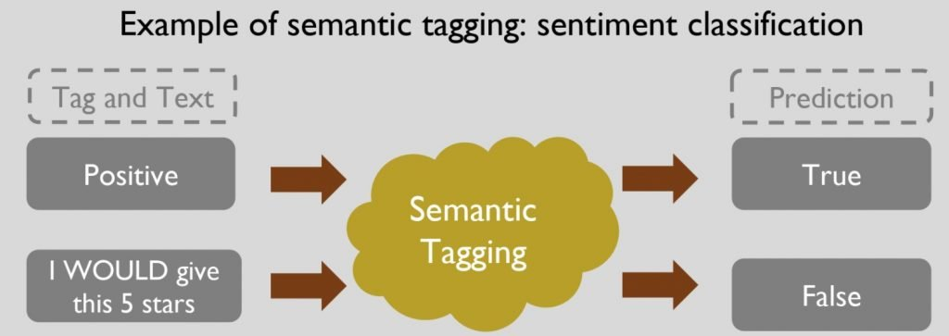
Machine-Learned Classification and Semantic Topic Tagging
An example of semantic tagging:

Slide 92
Machine-Learned Classification and Semantic Topic Tagging
Examples of Semantic Tagging Applications:
1) Suggestion Mining
Suggestion mining is one of the most popular applications of semantic tagging. A suggestion is a short yet practical piece of text that carries an actionable recommendation. Experience-sharing websites such as TripAdvisor and Yelp contain multitudes of suggestions in their user-generated text.
2) Product Description Generation
E-commerce websites such as Amazon and eBay collect innumerable customer reviews every day. Perhaps the most helpful part of these user-generated texts is the product description. Product descriptions from customer reviews often contain vital information that’s missing from their official counterparts.

Slide 93
Machine-Learned Classification and Semantic Topic Tagging
3) Humor
Although informative, reading online user reviews can be tedious and unpleasant. But when you add humor into the mix, it can bring readers happiness and attract attention from more of them.
4) Argument
Compared with sentimental comments like “the room is uncomfortable,” arguments provide factual evidence such as “the room has a smell of mold” to support or oppose an opinion. Since arguments are generally different opinions towards the same proposition, they often contain information from various perspectives that can be useful for explanations.

Slide 94
Machine-Learned Classification and Semantic Topic Tagging
Common Challenges of Semantic Tagging:
Despite the many benefits that semantic tagging offers, setting up an application pipeline for production data is not easy. Here are three common challenges:
Your pipeline will require extensive amounts of high-quality label data to be prepared for model training.
You’ll need to develop a series of computational operators to process raw data into numeric representations. Possible operators include data preprocessing, deduplication, and feature engineering. They can take an enormous amount of time and effort to create.
Pipeline performance strongly depends on selecting the most suitable machine learning model. Suboptimal models may tag undesired content such as fake or irrelevant comments or exclude legitimate sentiments.

Slide 95
Python Libraries for Text Summarization
some Python libraries commonly used for text summarization:
1- Numpy
2-Pandas
3-Nltk
4-Matplotlib

Slide 96
Python Libraries for Text Summarization
Numpy:-
Stands for Numerical Python
Is the fundamental package required for high performance computing and data analysis
NumPy is so important for numerical computations in Python is because it is designed for efficiency on large arrays of data.
It provides
ndarray for creating multiple dimensional arrays
Internally stores data in a contiguous block of memory, independent of other built-in Python objects, use much less memory than built-in Python sequences.
Standard math functions for fast operations on entire arrays of data without having to write loops
NumPy Arrays are important because they enable you to express batch operations on data without writing any for loops. We call this vectorization.

Slide 97
NumPy ndarray vs list
One of the key features of NumPy is its N-dimensional array object, or ndarray, which is a fast, flexible container for large datasets in Python.
Whenever you see “array,” “NumPy array,” or “ndarray” in the text, with few exceptions they all refer to the same thing: the ndarray object.
NumPy-based algorithms are generally 10 to 100 times faster (or more) than their pure Python counterparts and use significantly less memory.
import numpy as np
my_arr = np.arange(1000000)
my_list = list(range(1000000))

Slide 98
Python Libraries for Text Summarization
some Python libraries commonly used for text summarization:
1- Numpy
2-Pandas
3-Nltk
4-Matplotlib

Slide 99
ndarray
ndarray is used for storage of homogeneous data
i.e., all elements the same type
Every array must have a shape and a dtype
Supports convenient slicing, indexing and efficient vectorized computation
import numpy as np
data1 = [6, 7.5, 8, 0, 1]
arr1 = np.array(data1)
print(arr1)
print(arr1.dtype)
print(arr1.shape)
print(arr1.ndim)

Slide 100
Creating ndarrays
Using list of lists
import numpy as np
data2 = [[1, 2, 3, 4], [5, 6, 7, 8]] #list of lists
arr2 = np.array(data2)
print(arr2.ndim) #2
print(arr2.shape) # (2,4)

Slide 101
Creating ndarrays
array = np.array([[0,1,2],[2,3,4]])
[[0 1 2]
[2 3 4]]
array = np.zeros((2,3))
[[0. 0. 0.]
[0. 0. 0.]]
array = np.ones((2,3))
[[1. 1. 1.]
[1. 1. 1.]]
array = np.eye(3)
[[1. 0. 0.]
[0. 1. 0.]
[0. 0. 1.]]
array = np.arange(0, 10, 2)
[0, 2, 4, 6, 8]
array = np.random.randint(0, 10, (3,3))
[[6 4 3]
[1 5 6]
[9 8 5]]
arange is an array-valued version of the built-in Python range function
Notes:
array = np.eye(3, dtype=int)

Slide 102
Arithmatic with NumPy Arrays
Any arithmetic operations between equal-size arrays applies the operation element-wise:
arr = np.array([[1., 2., 3.], [4., 5., 6.]])
print(arr)
[[1. 2. 3.]
[4. 5. 6.]]
print(arr * arr)
[[ 1. 4. 9.]
[16. 25. 36.]]
print(arr - arr)
[[0. 0. 0.]
[0. 0. 0.]]
Notes:
np.array(list)

Slide 103
Arithmatic with NumPy Arrays
Arithmetic operations with scalars propagate the scalar argument to each element in the array:
Comparisons between arrays of the same size yield boolean arrays:
arr = np.array([[1., 2., 3.], [4., 5., 6.]])
print(arr)
[[1. 2. 3.]
[4. 5. 6.]]
print(arr **2)
[[ 1. 4. 9.]
[16. 25. 36.]]
arr2 = np.array([[0., 4., 1.], [7., 2., 12.]])
print(arr2)
[[ 0. 4. 1.]
[ 7. 2. 12.]]
print(arr2 > arr)
[[False True False]
[ True False True]]

Slide 104
Indexing and Slicing
One-dimensional arrays are simple; on the surface they act similarly to Python lists:
arr = np.arange(10)
print(arr) # [0 1 2 3 4 5 6 7 8 9]
print(arr[5]) #5
print(arr[5:8]) #[5 6 7]
arr[5:8] = 12
print(arr) #[ 0 1 2 3 4 12 12 12 8 9]

Slide 105
Indexing and Slicing
As you can see, if you assign a scalar value to a slice, as in arr[5:8] = 12, the value is propagated (or broadcasted) to the entire selection.
An important first distinction from Python’s built-in lists is that array slices are views on the original array.
This means that the data is not copied, and any modifications to the view will be reflected in the source array.
arr = np.arange(10)
print(arr) # [0 1 2 3 4 5 6 7 8 9]
arr_slice = arr[5:8]
print(arr_slice) # [5 6 7]
arr_slice[1] = 12345
print(arr) # [ 0 1 2 3 4 5 12345 7 8 9]
arr_slice[:] = 64
print(arr) # [ 0 1 2 3 4 64 64 64 8 9]
Notes:
As NumPy has been designed to be able to work with very large arrays, you could imagine performance
and memory problems if NumPy insisted on always copying data.
If you want a copy of a slice of an ndarray instead of a view, you
will need to explicitly copy the array—for example,
arr[5:8].copy().

Slide 106
Indexing
In a two-dimensional array, the elements at each index are no longer scalars but rather one-dimensional arrays:
Thus, individual elements can be accessed recursively. But that is a bit too much work, so you can pass a comma-separated list of indices to select individual elements.
So these are equivalent:
arr2d = np.array([[1, 2, 3], [4, 5, 6], [7, 8, 9]])
print(arr2d[2]) # [7 8 9]
print(arr2d[0][2]) # 3
print(arr2d[0, 2]) #3

Slide 107
Python Libraries for Text Summarization
some Python libraries commonly used for text summarization:
1- Numpy
2-Pandas
3-Nltk
4-Matplotlib

Slide 108
Why pandas?
Pandas
One of the most popular library that data scientists use
Labeled axes to avoid misalignment of data
When merge two tables, some rows may be different
Missing values or special values may need to be removed or replaced
 | height | Weight | Weight2 | age | Gender
Amy | 160 | 125 | 126 | 32 | 2
Bob | 170 | 167 | 155 | -1 | 1
Chris | 168 | 143 | 150 | 28 | 1
David | 190 | 182 | NA | 42 | 1
Ella | 175 | 133 | 138 | 23 | 2
Frank | 172 | 150 | 148 | 45 | 1
 | salary | Credit score
Alice | 50000 | 700
Bob | NA | 670
Chris | 60000 | NA
David | -99999 | 750
Ella | 70000 | 685
Tom | 45000 | 660

Slide 109
Pandas
Created by Wes McKinney in 2008, now maintained by many others.
Author of one of the textbooks: Python for Data Analysis
Powerful and productive Python data analysis and Management Library
Panel Data System
The name is derived from the term "panel data", an econometrics term for data sets that include both time-series and cross-sectional data
Its an open source product.

Slide 110
Overview - 2
Pandas
Python Library to provide data analysis features similar to: R, MATLAB, SAS
Rich data structures and functions to make working with data structure fast, easy and expressive.
It is built on top of NumPy
Key components provided by Pandas:
Series
DataFrame
From now on:
from pandas import Series, DataFrame
import pandas as pd

Slide 111
Series
Series
One dimensional array-like object
It contains array of data (of any NumPy data type) with associated indexes. (Indexes can be strings or integers or other data types.)
By default , the series will get indexing from 0 to N where N = size -1
from pandas import Series, DataFrame
import pandas as pd
obj = Series([4, 7, -5, 3])
print(obj)
print(obj.index)
print(obj.values)
#Output
0 4
1 7
2 -5
3 3
dtype: int64
RangeIndex(start=0, stop=4, step=1)
[ 4 7 -5 3]

Slide 112
Series – referencing elements
obj2 = Series([4, 7, -5, 3], index=['d', 'b', 'a', 'c'])
print(obj2)
#Output
d 4
b 7
a -5
c 3
dtype: int64
print(obj2.index)
#Output
Index(['d', 'b', 'a', 'c'], dtype='object')
print(obj2.values)
#Output
[ 4 7 -5 3]
print(obj2['a'])
#Output
-5
obj2['d']= 10
print(obj2[['d', 'c', 'a']])
#Output
d 10
c 3
a -5
dtype: int64
print(obj2[:2])
#Output
d 10
b 7
dtype: int64
print(obj2.a)
#Output
-5

Slide 113
Series – array/dict operations
Can be thought of as a dict. Can be constructed from a dict directly.
obj3 = Series({'d': 4, 'b': 7, 'a': -5, 'c':3 })
print(obj3)
#output
d 4
b 7
a -5
c 3
dtype: int64
obj4 = obj3[obj3>0]
print(obj4)
#output
d 10
b 7
c 3
dtype: int64
print(obj3**2)
#output
d 100
b 49
a 25
c 9
dtype: int64
print(‘b’ in obj3)
#output
true
numpy array operations can also be applied, which will preserve the index-value link

Slide 114
Series – from dictionary
print(pd.isnull(obj4))
#output
Texas False
Ohio False
Oregon False
Iowa True
dtype: bool
print(pd.notnull(obj4))
#output
Texas True
Ohio True
Oregon True
Iowa False
dtype: bool
print(obj4[obj4.notnull()])
#output
Texas 10.0
Ohio 20.0
Oregon 15.0
dtype: float64
sdata = {'Texas': 10, 'Ohio': 20, 'Oregon': 15, 'Utah': 18}
states = ['Texas', 'Ohio', 'Oregon', 'Iowa']
obj4 = Series(sdata, index=states)
print(obj4)
#output
Texas 10.0
Ohio 20.0
Oregon 15.0
Iowa NaN
dtype: float64
dictionary
Missing value

Slide 115
DataFrame
A DataFrame is a tabular data structure comprised of rows and columns, akin to a spreadsheet or database table.
It can be treated as an ordered collection of columns
Each column can be a different data type
Have both row and column indices
data = {'state': ['Ohio', 'Ohio', 'Ohio', 'Nevada', 'Nevada'],
'year': [2000, 2001, 2002, 2001, 2002],
'pop': [1.5, 1.7, 3.6, 2.4, 2.9]}
frame = DataFrame(data)
print(frame)
#output
state year pop
0 Ohio 2000 1.5
1 Ohio 2001 1.7
2 Ohio 2002 3.6
3 Nevada 2001 2.4
4 Nevada 2002 2.9

Slide 116
DataFrame – specifying columns and indices
Order of columns/rows can be specified.
Columns not in data will have NaN.
frame2 = DataFrame(data, columns=['year', 'state', 'pop', 'debt'], index=['A', 'B', 'C', 'D', 'E'])
Print(frame2)
year state pop debt
A 2000 Ohio 1.5 NaN
B 2001 Ohio 1.7 NaN
C 2002 Ohio 3.6 NaN
D 2001 Nevada 2.4 NaN
E 2002 Nevada 2.9 NaN
Same order
Initialized with NaN

Slide 117
DataFrame – from nested dict of dicts
Outer dict keys as columns and inner dict keys as row indices
pop = {'Nevada': {2001: 2.9, 2002: 2.9}, 'Ohio': {2002: 3.6, 2001: 1.7, 2000: 1.5}}
frame3 = DataFrame(pop)
print(frame3)
#output
Nevada Ohio
2000 NaN 1.5
2001 2.9 1.7
2002 2.9 3.6
Transpose
print(frame3.T)
2000 2001 2002
Nevada NaN 2.9 2.9
Ohio 1.5 1.7 3.6
Union of inner keys (in sorted order)

Slide 118
DataFrame – index, columns, values
frame3.index.name = 'year'
frame3.columns.name='state‘ print(frame3)
state Nevada Ohio
year
2000 NaN 1.5
2001 2.9 1.7
2002 2.9 3.6
print(frame3.index)
Int64Index([2000, 2001, 2002], dtype='int64', name='year')
print(frame3.columns)
Index(['Nevada', 'Ohio'], dtype='object', name='state')
print(frame3.values)
[[nan 1.5]
[2.9 1.7]
[2.9 3.6]]

Slide 119
DataFrame – retrieving a column
A column in a DataFrame can be retrieved as a Series by dict-like notation or as attribute
data = {'state': ['Ohio', 'Ohio', 'Ohio', 'Nevada', 'Nevada'],
'year': [2000, 2001, 2002, 2001, 2002],
'pop': [1.5, 1.7, 3.6, 2.4, 2.9]}
frame = DataFrame(data)
print(frame['state'])
0 Ohio
1 Ohio
2 Ohio
3 Nevada
4 Nevada
Name: state, dtype: object
print(frame.state)
0 Ohio
1 Ohio
2 Ohio
3 Nevada
4 Nevada
Name: state, dtype: object

Slide 120
Other DataFrame functions
mean()
Mean(axis=0, skipna=True)
sum()
cumsum()
describe(): return summary statistics of each column
for numeric data: mean, std, max, min, 25%, 50%, 75%, etc.
For non-numeric data: count, uniq, most-frequent item, etc.
corr(): correlation between two Series, or between columns of a DataFrame
corr_with(): correlation between columns of DataFram and a series or between the columns of another DataFrame

Slide 121
Python and Natural Language Processing
Python is a great language for NLP:
Simple
Easy to debug:
Exceptions
Interpreted language
Easy to structure
Modules
Object oriented programming
Powerful string manipulation

Slide 122
Modules and Packages
Python modules “package program code and data for reuse.” (Lutz)
Similar to library in C, package in Java.
Python packages are hierarchical modules (i.e., modules that contain other modules).
Three commands for accessing modules:
import
from…import
reload

Slide 123
Modules and Packages: import
The import command loads a module:
# Load the regular expression module
>>> import re
To access the contents of a module, use dotted names:
# Use the search method from the re module
>>> re.search(‘\w+’, str)
To list the contents of a module, use dir:
>>> dir(re)
[‘DOTALL’, ‘I’, ‘IGNORECASE’,…]

Slide 124
Modules and Packages: import
The from…import command loads individual functions and objects from a module:
# Load the search function from the re module
>>> from re import search
Once an individual function or object is loaded with from…import, it can be used directly:
# Use the search method from the re module
>>> search (‘\w+’, str)

Slide 125
Import vs. from…import
Import
Keeps module functions separate from user functions.
Requires the use of dotted names.
Works with reload.
from…import
Puts module functions and user functions together.
More convenient names.
Does not work with reload.

Slide 126
Modules and Packages: reload
If you edit a module, you must use the reload command before the changes become visible in Python:
>>> import mymodule
...
>>> reload (mymodule)
The reload command only affects modules that have been loaded with import; it does not update individual functions and objects loaded with from...import.

Slide 127
Introduction to NLTK
The Natural Language Toolkit (NLTK) provides:
Basic classes for representing data relevant to natural language processing.
Standard interfaces for performing tasks, such as tokenization, tagging, and parsing.
Standard implementations of each task, which can be combined to solve complex problems.

Slide 128
NLTK: Example Modules
nltk.token: processing individual elements of text, such as words or sentences.
nltk.probability: modeling frequency distributions and probabilistic systems.
nltk.tagger: tagging tokens with supplemental information, such as parts of speech or wordnet sense tags.
nltk.parser: high-level interface for parsing texts.
nltk.chartparser: a chart-based implementation of the parser interface.
nltk.chunkparser: a regular-expression based surface parser.

Slide 129
NLTK: Top-Level Organization
NLTK is organized as a flat hierarchy of packages and modules.
Each module provides the tools necessary to address a specific task
Modules contain two types of classes:
Data-oriented classes are used to represent information relevant to natural language processing.
Task-oriented classes encapsulate the resources and methods needed to perform a specific task.

Slide 130
What is Matplotlib?
Matplotlib is a low level graph plotting library in python that serves as a visualization utility.
Matplotlib was created by John D. Hunter.
Matplotlib is open source and we can use it freely.
Matplotlib is mostly written in python, a few segments are written in C, Objective-C and Javascript for Platform compatibility.
Import Matplotlib
Once Matplotlib is installed, import it in your applications by adding the import module statement:
import matplotlib

Slide 131
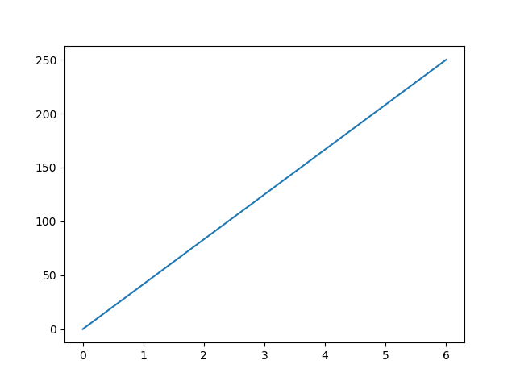
Matplotlib
Pyplot
Most of the Matplotlib utilities lies under the pyplot submodule, and are usually imported under the plt alias:
import matplotlib.pyplot as plt
Now the Pyplot package can be referred to as plt.
Example
Draw a line in a diagram from position (0,0) to position (6,250):
import matplotlib.pyplot as plt import numpy as np xpoints = np.array([0, 6]) ypoints = np.array([0, 250]) plt.plot(xpoints, ypoints) plt.show()

Slide 132
Matplotlib
Matplotlib is a comprehensive and widely-used 2D plotting library for the Python programming language. It provides a versatile set of tools for creating a variety of static, animated, and interactive visualizations in Python scripts, applications, and interactive computing environments. Matplotlib is particularly popular in the fields of data science, scientific research, and engineering due to its flexibility and ease of use.
Matplotlib is a foundational library in the Python ecosystem for data visualization and is often used in conjunction with other libraries such as NumPy, pandas, and SciPy to analyze and visualize data effectively. Its flexibility and extensive documentation make it a powerful tool for both beginners and experienced developers in the Python community.

Slide 133
Questions
What is semantic tagging?
Why semantic tags are used?
Why semantic features are important?

Slide 134
Glossary Questions
………………most important idea of text.
Paragraph a semantic tag(True or False)
Are semantic tags strong(True or False)
What is LSA in topic modelling?
How do you validate topic models?
……………. is an example of topic modelling.

